Slide 1
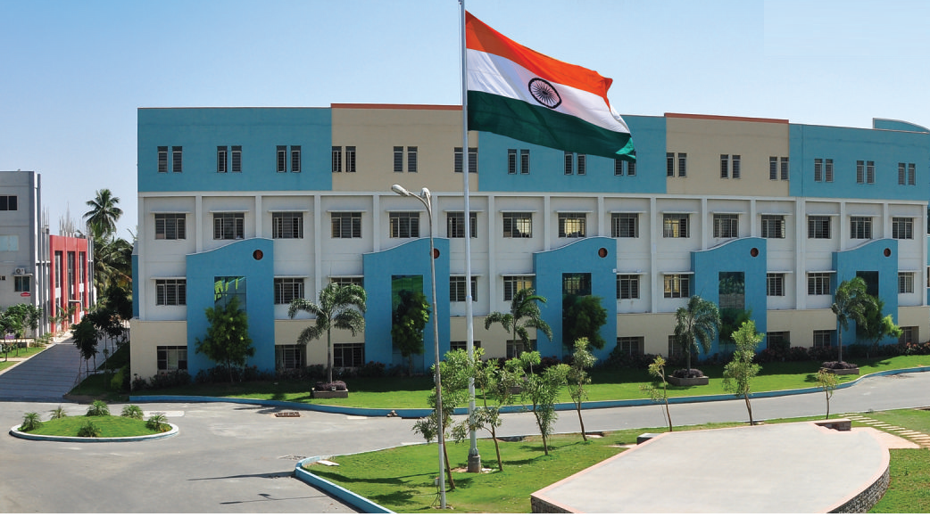
SRI ESHWAR COLLEGE OF ENGINEERING academic year : 2017-18 department : civil
FIRST project review
Date of review : 02.08.2017

Slide 2
PLANNING ,ANALYSIS AND DESIGN OF CHECKDAM
Batch Members
1 THIVAKAR.R
2 RAMESH.T.R
3 MOHAMED MUNEERUL HUDHA
Guide Name
J.ROBINSON
ASSITANT PROFESSOR
DEPARTMENT OFCIVIL ENGINEERING

Slide 3
Presentation Outline
Abstract
Objective
Data required for planning checkdam
Introduction
Literature Survey
Methodology
Work schedule
Project outcome

Slide 4
Abstract of the project
This project is done with help of coodu organisation .This project about the construction of check dam to store run off water in thayanur village near karamadai in coimbatore .From this checkdam nearly twenty five villages will get prosperity. This checkdam bulit for purpose of reduce the water scarcity for cultivation purpose during summer season .

Slide 5
Objectives
The broad objectives of check dam are:
To enhance the agricultural development
To sustain the drinking water for future uses
To reduce the velocity rate of storm water
To avoid the soil erosion
Ground water recharge

Slide 6
Data required for planning the checkdam
Soil bearing capacity
Annual rainfall
Contour maps
Ground water level
Catchment area
Watershed area
Permeability of rocks
Bed level
Low sediments
Shape of storage basin

Slide 7
Introduction
A check dam also called as gully plugs
A check dam is small dam structure constructed across a swale ,drainage or waterway to reduce the velocity flow of water
Check dam are an ancient technique dating all the way back to the second century
They can used not only to reduce the velocity of water but also to distribute flow towards vegetation

Slide 8
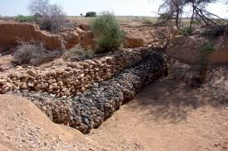
OLD CHECKDAM

Slide 9
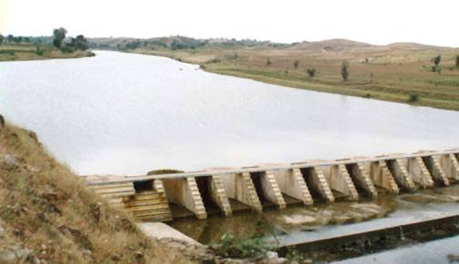
CHECK DAM

Slide 10
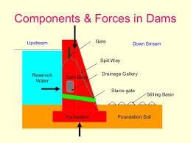
COMPONENTS OF CHECKDAM

Slide 11
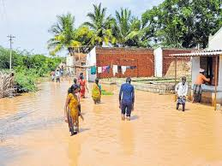
EFFECT OF FLOOD

Slide 12
Design considerations
Minimum risk of submergence of cropped land during sudden flood
It should have high cost benefit ratio
There should be high percentage of cropped area on either side of the river
The structure should be able to store a high volume of rain water over a long duration of time

Slide 13
It should have provide across length of river basin

Slide 14
LITERATURE SURVEY

Slide 15
Key Skills
PUBLICATION | TOPIC | INFERENCE | CONCLUSION | ISSUE
IJRET : INTERNATIONAL JOURNAL OF RESEARCH IN ENGINEEERING AND TECHNOLOGY | A REVIEW ON AQUIFER RECHARGE BY CHECK DAM : A CASE STUDY NEAR CHENNAI | INCREASE IN GROUND WATER LEVEL BY MANAGED AQUIFER RECHARGE (MAR) | MAR THROUGH CHECK DAM IS THE BEST METHOD TO IMPROVE THE GROUND WATER HEAD AND IMPROVETHE LIVELIHOOD OF THE COMMUNITY | APRIL 2013
IJEAS – INTERNATIONAL JOURNAL OF ENGINEERING AND APPLIED SCIENCES | IMPORTANCE AND PRINCIPLE BEHIND THE CONSTRUCTION OF CHECKDAM INMICROWATER SHED AREAS | TO ENHANCE THE WATERSHED MANAGEMENT AND TO IMPROVE THE AGRICULTURAL CULITIVITY | A CONSEQUENCE OF THE CHECK DAM CONSTRUCTION IS THE CREATION OF A NEW TYPE OF AGRICULTURE WHICH EMERGES AS MORE AND MORE FOOD SUPPLIES FROM THE DAM FARMLAND | JANUARY 2015

Slide 16
Explanation
PUBLICATION | TOPIC | INFERENCE | CONCLUSION | ISSUE
BONFRING INTERNATIONAL JOURNAL OF INDUSTRIAL ENGINEERING AND MANAGEMENT STUDIES | CHECKDAM CONSTRUCTION BY PRIORTIZATION OF MICRO WATERSHED USING MORPHOMETRIC ANALYSIS USING GIS AND REMOTE SENSING | BY USING ARC GIS TO IDENTIFY THE AREAS TO BULID THE CHECK DAM | TO DEMONSTRATE THE CAPABILIES OF REMOTE SENSING AND GIS TO STUDY THE GEOMETICAL ASPECT OF THE WATERSHED | JULY 2012
INTERNATIONAL JOURNAL OF ENGINEERING SCIENCE AND COMPUTING | PLANNING DESIGN AND ESTIMATION OF CHECK DAM | THE SURVEY WORK CARRIED WITH THE AUTO LEVEL INSTRUCMENT | THIS METHOD OF DESIGN IS CONSIDERED TO BE BETTER THAN OTHER METHOD TO DESIGNFOR CHECKDAM | APRIL 2017

Slide 17
PUBLICATION | TOPIC | INFERENCE | CONCLUSION | ISSUE
INDIAN JOURNAL OF SCIENCE AND TECHNOLOGY | EFFECTIVENESS OF ARITIFICIAL RECHARGE STRUCTURES IN ENHANCING GROUNDWATER STORAGE | COMPARISON OF SITUATIONS WITH AND WITHOUT ARIFICIAL RECHARGES | FROM THE DIFFERENT ARITICIAL STRUCTURES ,THE PERCOLATION POND WITH PERCOLATION WELL WAS FOUND TO BE MORE EFFECTIVE RECHARGING THE GROUND WATER | AUGUST 2015
ISSN | HYDROLOGICAL ANALYSIS AND DESIGN OF CHECK DAM FOR WATE SUPPLY | BY STUDYING HYDROLOGICAL ANALYSIS AND CONTOUR OF PARTICULAR AREA TO DESIGN THE CHECKDAM | A THOROUGH KNOWLEDGE ON THE HYDROLOGICAL ANALYSIS IS RELEVANT FOR DESIGNING SUCH STRUCTURES SAFELY AND ECONOMICALLY | 2016

Slide 18
PUBLICATION | TOPIC | INFERENCE | CONCLUSION | ISSUE
12TH ISCO CONFERENCE | CHECKDAM SYSTEM IN GULLIES – THE MOST EFFECTIVE MEASURE TO CONSERVE SOIL AND WATER IN CHINA OESS PLATEAU | TO REDUCE THE SOIL AND WATER EROSION IN LOESS PLATEAU AND STRATEGY TO YELLOW RIVER CONTROL THE | TO STUDY THE RELATIVE AND OPTIMUM DESIGN FOR CHECKDAM | BEIJING 2002
INTERNATIONAL JOURNAL OF ENVIRONMENTAL SCIENCE AND DEVELOPMENT | MAKING SMALLCHECK DAM FOR WATER PRESERVATION FROM RAINY SEASON UPTO DRY SEASON IN EASTERN REGION OF THAILAND | PROS AND CONS OF DIFFERENT MATERIALS USED TO CONSTRUCT THE CHECKDAM | INFRASTRUCTURE LIKE REINFORCEMENT INTO MADE WITH FOR CONVENIENT REUSEMATERIAL | OCTOBER 2011

Slide 19
PUBLICATION | TOPIC | INFERENCE | CONCLUSION | ISSUE
JOURNAL OF REMOTE SENSING AND GIS | SITE STABILITY ANALYSIS FOR SMALL MULTIPURPOSE DAMS USING GEOSPATIAL TECHNOLOGIES | BY ANALYSISG FLOOD AREAS AND VOLUME ESTI MATION OF RAINFALL BY USING GEOSPATIAL TECHNOLOGIES | THE DAM SITSES SELECTED COULD BE EFFECTIVELY USED FOR EFFICIENT STORAGE OF WATER DURING RAINY SEASONS WHEN THE DISCHARGE DECREASES TO VERY LEAST EXTENT | 2016
JOURNAL OF WATER RESOURCE PROTECTION | CHECKDAM IN AN EPHRMEARLAL STREAM IN AN TROPICAL DECIDUOUS FOREST EXTEND WATER PERIOD IN A MINIMAL EFFECT ON REPTILE ASSEMBLAGE | THE CHECKDAM CAN EFFECTIVELY PROLONG WATER A TO THE AND MOISTURE HABITAT WITH MINIMAL EFFECT ON THE REPTILE ASSEMBLAGE IN THE AREA | CHECKDAM EFFCT ON THE EXISTING REPTILE DIVERSITY AND COMPOSITIN IN THIS AREA . CHECK DAM IS THE WAY TO PROLONG THE UTILIZABLE WATER IN THE AREA WITH MINIMAL EFFCT ON THE REPTILEASSEMBLAGE | 2012

Slide 20
Journal Publications related to the Project
INTERNATIONAL JOURNAL OF RESEARCH IN ENGINEEERING AND TECHNOLOGY, “A REVIEW ON AQUIFER RECHARGE BY CHECK DAM : A CASE STUDY NEAR CHENNAI “,APRIL 2013.
IJEAS –INTERNATIONAL JOURNAL OF ENGINEERING AND APPLIED SCIENCES ,”IMPORTANCE AND PRINCIPLE BEHIND THE CONSTRUCTION OF CHECKDAM IN MICROWATER SHED AREAS”,JANUARY 2015.

Slide 21
BONFRING INTERNATIONAL JOURNAL OF INDUSTRIAL ENGINEERING AND MANAGEMENT STUDIES , ”CHECKDAM CONSTRUCTION BY PRIORTIZATION OF MICRO WATERSHED USING MORPHOMETRIC ANALYSIS USING GIS AND REMOTE SENSING”,JULY 2012
INTERNATIONAL JOURNAL OF ENGINEERING SCIENCE AND COMPUTING , ” PLANNING DESIGN AND ESTIMATION OF CHECK DAM”,APRIL 2017.
INDIAN JOURNAL OF SCIENCE AND TECHNOLOGY,” EFFECTIVENESS OF ARITIFICIAL RECHARGE STRUCTURES IN ENHANCING GROUNDWATER STORAGE”,AUGUST 2015.

Slide 22
ISSN,”HYDROLOGICAL ANALYSIS AND DESIGN OF CHECK DAM FOR WATER SUPPLY”,2016
12TH ISCO CONFERENCE,” CHECKDAM SYSTEM IN GULLIES – THE MOST EFFECTIVE MEASURE TO CONSERVE SOIL AND WATER IN CHINA TOESS PLATEAU”,BEIGING 2002.
INTERNATIONAL JOURNAL OF ENVIRONMENTAL SCIENCE AND DEVELOPMENT,” MAKING SMALLCHECK DAM FOR WATER PRESERVATION FROM RAINY SEASON UPTO DRY SEASON IN EASTERN REGION OF THAILAND”,OCTOBER 2011.

Slide 23
JOURNAL OF REMOTE SENSING AND GIS,” SITE STABILITY ANALYSIS FOR SMALL MULTIPURPOSE DAMS USING GEOSPATIAL TECHNOLOGIES”,2016
JOURNAL OF WATER RESOURCE PROTECTION, ” CHECKDAM IN AN EPHRMEARLAL STREAM IN AN TROPICAL DECIDUOUS FOREST EXTEND WATER PERIOD IN A MINIMAL EFFECT ON REPTILE ASSEMBLAGE”,2012

Slide 24
Methodology
Survey
Analysing existing data
Selection of site
Planning of checkdam
Analysis of checkdam
Design of checkdam

Slide 25
S.NO | DATE | WORK TO BE DONE | REMARKS
1 | 07-07-2017 | ZEROTH REVIEW
2 | 26-07-2017 | COODU OFFICE VISIT
3 | 28-07-2017 | SITE VISIT
4 | 02-08-2017 | FIRST REVIEW
5 | 09-08-2017 | Line study
6 | 12-08-2017 | Planning of check dam
7 | 19-08-2017 | Analysis using STADD PRO (Second Review)
8 | 08-09-2017 | Design using manual calculation
9 | 18-09-2017 | Conclusion ( Third Review)
 | 28-09-2017 | Final Review – Book Submission

Slide 26
Project Outcome
The project outcome will be the checkdam that satisfy needs of the farmer during drought period
They will produce large yield compared to previous year
They will prospered from this project

Slide 27
Thanks to Coodu organisation

